Slide 1
Bimodal Modelling of Source Code and Natural Language
Authors:
Miltiadis Allamanis,
Daniel Tarlow, Andrew D. Gordon, Yi Wei @ Microsoft
Presented by:
Hongfei Hu
Mar/16/2016

Slide 2
Overview
Motivation
Terminologies and Preliminaries
Joint Models
Evaluation
Discussion

Slide 3
Motivation
Software ➔ important
Writing and Maintaining software ➔ costly
make sense of large existing code bases
look at documentation and online resources
➔CHALLENGING!
A new Tool! make writing and understanding software faster and easier

Slide 4

Terminologies
$ℒ$: sequence of words in natural Language
$𝒞$: source Code snippet
Formulate a model using P($𝒞 | ℒ$), not P($ℒ | 𝒞$)
because it leads to the more natural way of encoding known structure of source code
Notes:
First high level

Slide 5

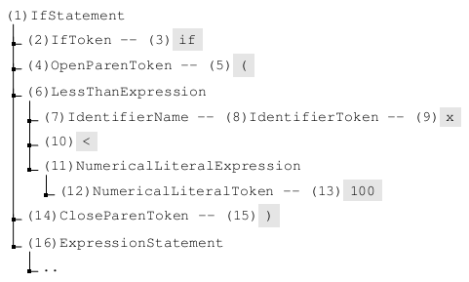
Preliminaries
Parsing Tree of
➔ Tokens
Notes:
How to represent source code

Slide 6

Preliminaries – Notations
A parse tree $𝒞=(𝒩, ch, val)$
$𝒩$: nodes {1, 2, 3, …, N}
ch: children function, $𝒩→𝒩^{∗}$
val: value function.
E.g. val(3)=if

Slide 7
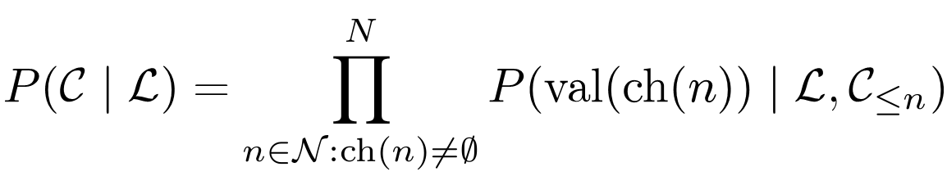
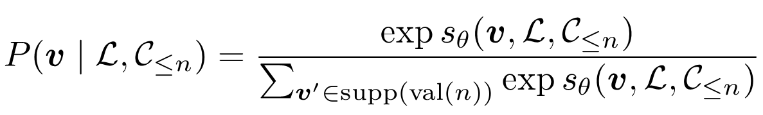

Preliminaries – Model Overview
Sequentially generates a child tuple for node n
$$supp\left(i\right)=\{v:v=val\left(ch\left(n\right)\right), val\left(n\right)=i\}$$
Notes:
sequentially generates a child tuple for node n conditional upon the natural language input
fixing the root node, sampling a children tuple conditional upon the initial partial tree (just the root node), then recursing to the left-most childnsuch
that val(n) 2 I, updating the partial tree

Slide 8
Preliminaries – Quiz
Please give the answers of (1) ch(6) (2) val(6)

Slide 9
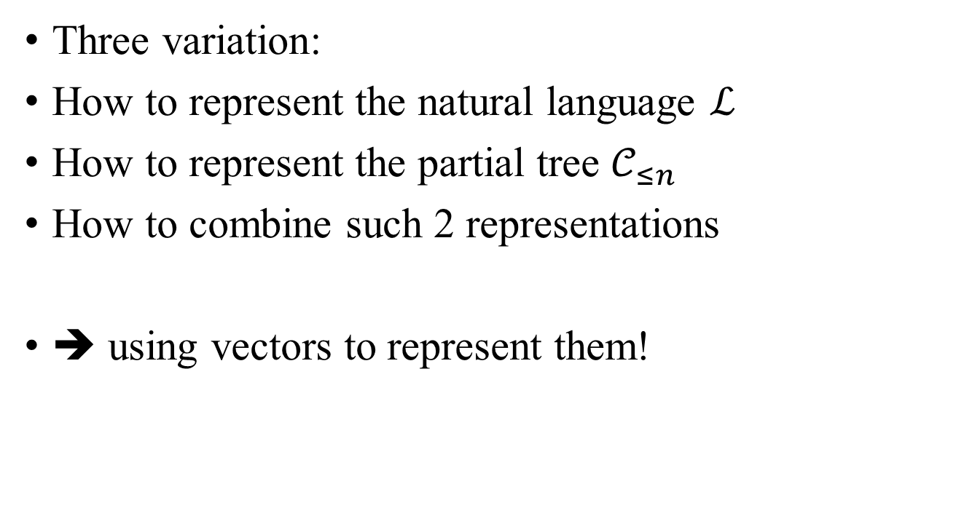
Joint Models
Three variation:
How to represent the natural language $ℒ$
How to represent the partial tree $𝒞_{≤n}$
How to combine such 2 representations
➔ using vectors to represent them!

Slide 10
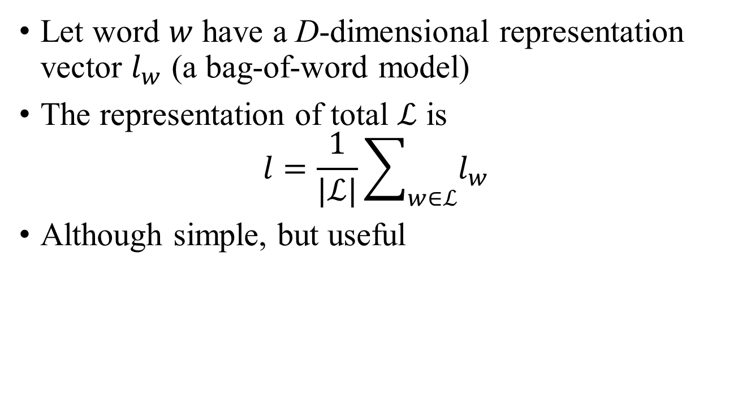
Joint Models – Natural Language
Let word $w$ have a D-dimensional representation vector $l_{w}$ (a bag-of-word model)
The representation of total $ℒ$ is
$$l=\frac{1}{|ℒ|}\sum_{w∈ℒ}{l_{w}}$$
Although simple, but useful
Notes:
simplistic

Slide 11
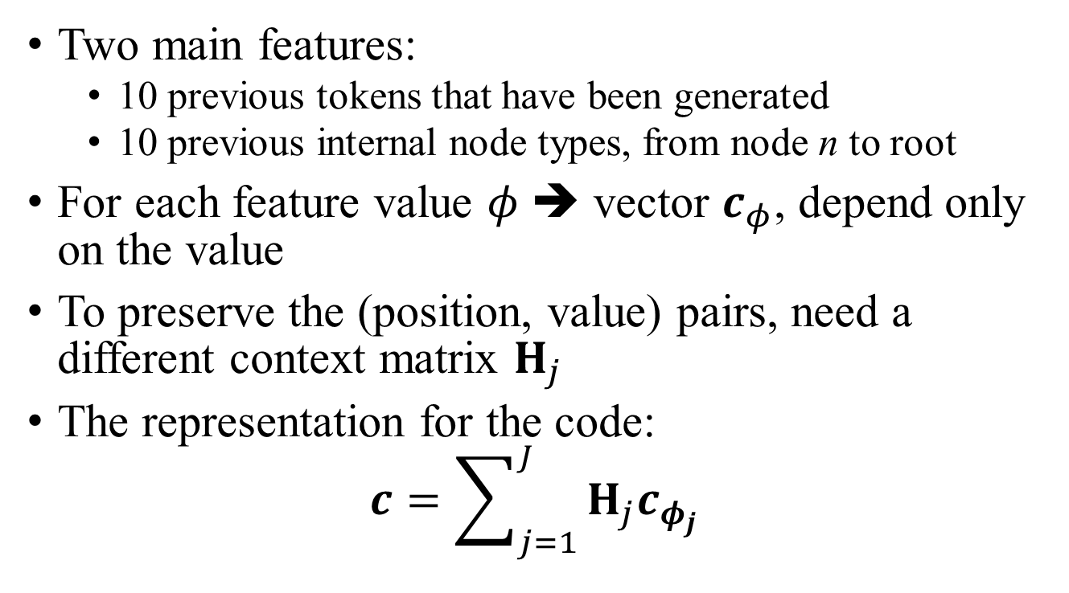
Joint Models – Partial Tree
Two main features:
10 previous tokens that have been generated
10 previous internal node types, from node n to root
For each feature value $φ$ ➔ vector $c_{φ}$, depend only on the value
To preserve the (position, value) pairs, need a different context matrix $H_{j}$
The representation for the code:
$$c=\sum_{j=1}^{J}{H_{j}c_{φ_{j}}}$$

Slide 12
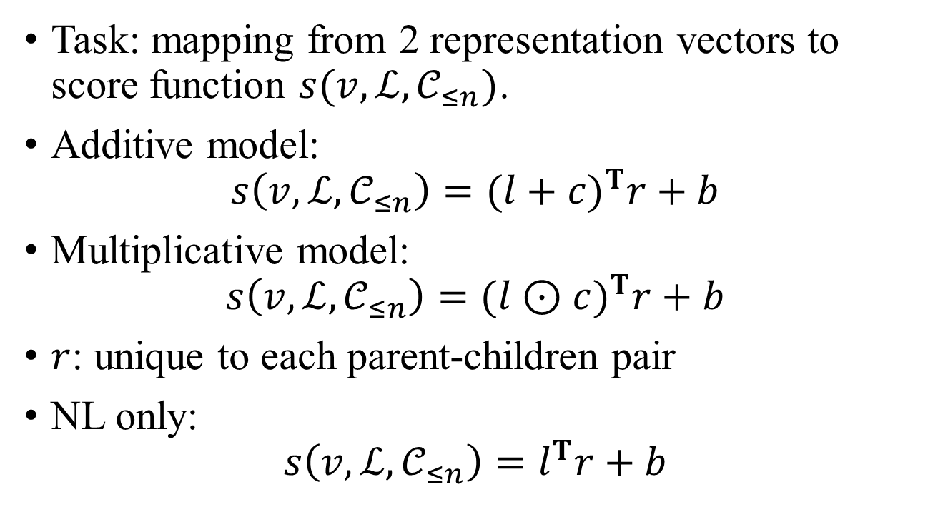
Joint Models – Combination
Task: mapping from 2 representation vectors to score function $s(v, ℒ,𝒞_{≤n})$.
Additive model:
$$s\left(v, ℒ,𝒞_{≤n}\right)={(l+c)}^{T}r+b$$
Multiplicative model:
$$s\left(v, ℒ,𝒞_{≤n}\right)={(l⊙c)}^{T}r+b$$
$r$: unique to each parent-children pair
NL only:
$$s\left(v, ℒ,𝒞_{≤n}\right)=l^{T}r+b$$

Slide 13

Joint Models – Learning
noise contrastive estimation (NCE) training
(learning word embeddings)
Objective:

Slide 14
Evaluation
Using Roslyn to parse C#
3 data sets for each evaluation sets:
Trainset: 70% of the snippets
Test1: 70% of the snippets & novel natural language queries (if any)
Test2: 30% of the snippets & associated natural language queries
Each snippet is described by a constant number of queries

Slide 15
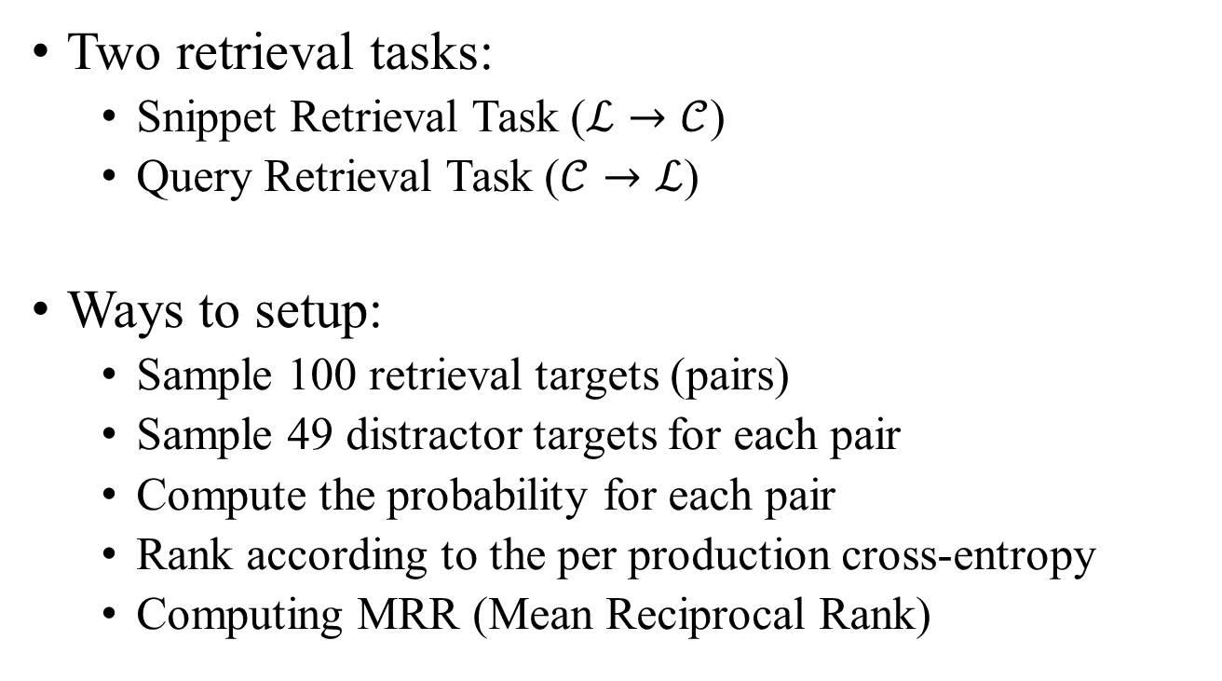
Evaluation
Two retrieval tasks:
Snippet Retrieval Task ($ℒ→𝒞$)
Query Retrieval Task ($𝒞→ℒ$)
Ways to setup:
Sample 100 retrieval targets (pairs)
Sample 49 distractor targets for each pair
Compute the probability for each pair
Rank according to the per production cross-entropy
Computing MRR (Mean Reciprocal Rank)

Slide 16
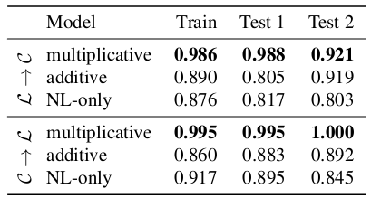
Evaluation – Synthetic Datasets
Text dataset: generated by the authors.
Operations on delimited strings, such as uppercasing, getting the length.
Natural language part: synthetic + from LINQ queries
163 snippets with 27 natural language queries
D = 20

Slide 17
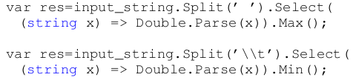
Evaluation – Synthetic Datasets
It can correctly generate previously unseen snippets from new natural language queries
Query: each element parse double separated by a tab and get max:
learned
from

Slide 18
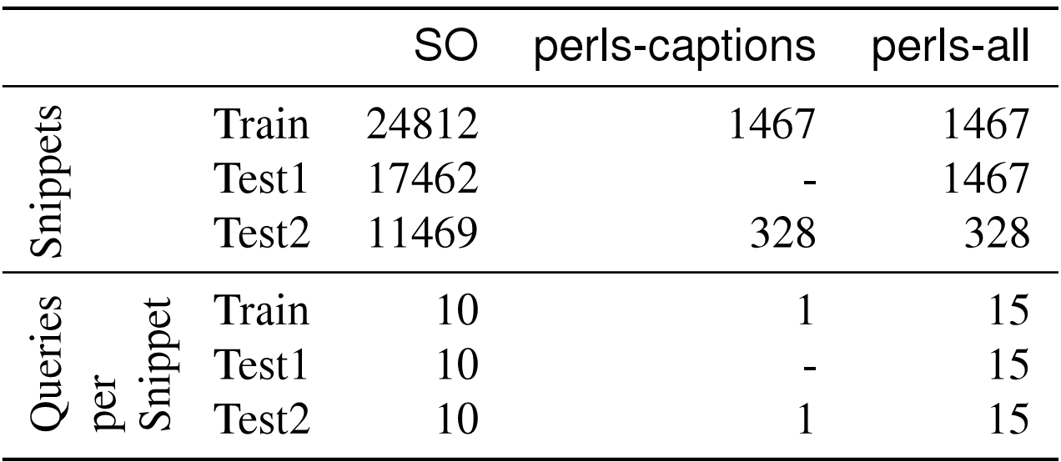
Evaluation – Real-world Datasets
Two sources:
StackOverflow (SO), title as the natural language & snippets in the answer as source code.
Dot Net Perls (perls-all), similar
To enlarge the NL data, adding search engine queries
Notes:
Filtered some illegal data, such as the answer voted less than 2 times, or too long or too short for the answer, or cannot be parsed by Roslyn

Slide 19
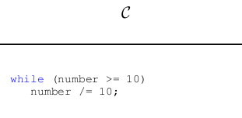
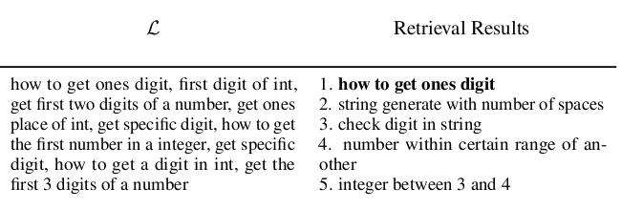
Evaluation – Real-world Datasets
Example:

Slide 20
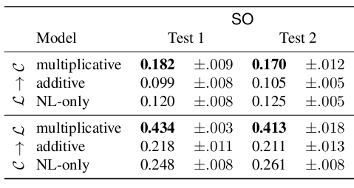
Evaluation
D = 50

Slide 21
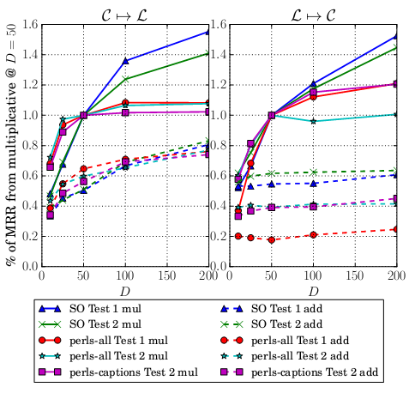

Slide 22
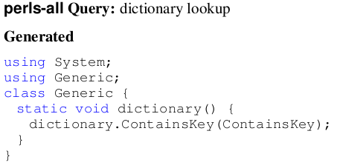
Evaluation
Far from ground-truth
Can find similar word from method name or others

Slide 23
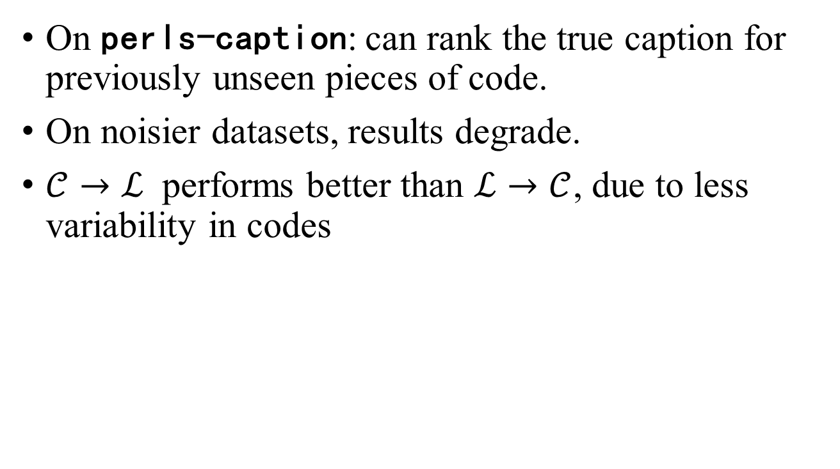
Discussion
On perls-caption: can rank the true caption for previously unseen pieces of code.
On noisier datasets, results degrade.
$𝒞→ℒ$ performs better than $ℒ→𝒞$, due to less variability in codes

Slide 24
Thanks! Q&A

